Slide 1
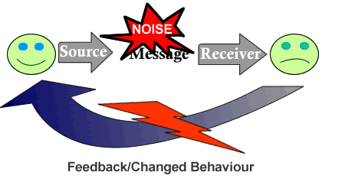
COMMUNICATION BARRIERS

Slide 2
Definition
Communication barriers are hindrances that you encounter in the process of communication that results in distortion of the message. It interferes with interpretation of meaning.

Slide 3
Types of barriers
Semantic
Organizational
Cultural
Psychological

Slide 4
Semantic barriers
Unfamiliar Vocabulary
Language
Use of jargon/ technical terms
Poor grammar and punctuation
Unclear message

Slide 5
Organizational barriers
Long chain of command
Policies , rules and regulations
Communication overload
Fear of superiors
Wrong choice of medium

Slide 6
Psychological barriers
Attitudes and values
Past experiences
Differences in perception
Abstraction
Resistance to change

Slide 7
Other barriers
Lack of knowledge
Cultural barriers
Time and distance
Technical problems
Poor communication skills

Slide 8
Solutions to the barriers
Sharpening communication skills
Appreciating other cultures/ open mindedness
Use clear and precise messages
Give long messages in chunks
Use simple language: avoid slung and jargon
Avoid prejudice
Be sensitive to the receiver
Carefully select channel

Slide 9
Conclusion
Even though physical barriers are rapidly being eliminated by technology, psychological barriers are getting complex to solve because of complexities of societies and increasing intercultural interactions.
Minimizing the effects of these barriers would improve communication.

Slide 10
Adapted from http://www.slideshare.net/sreenath.s/communication-barriersA
Thank you

